Slide 1
Introduction to Machine Learning
James H. Faghmous, Ph.D.

Slide 2
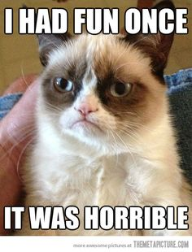
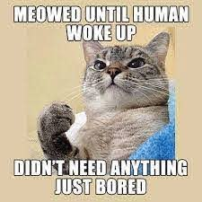

How to automate cat memes?!
You LOVE cat memes
Too many images on the internet!
How can you automate the process of finding new cat photos?

Slide 3
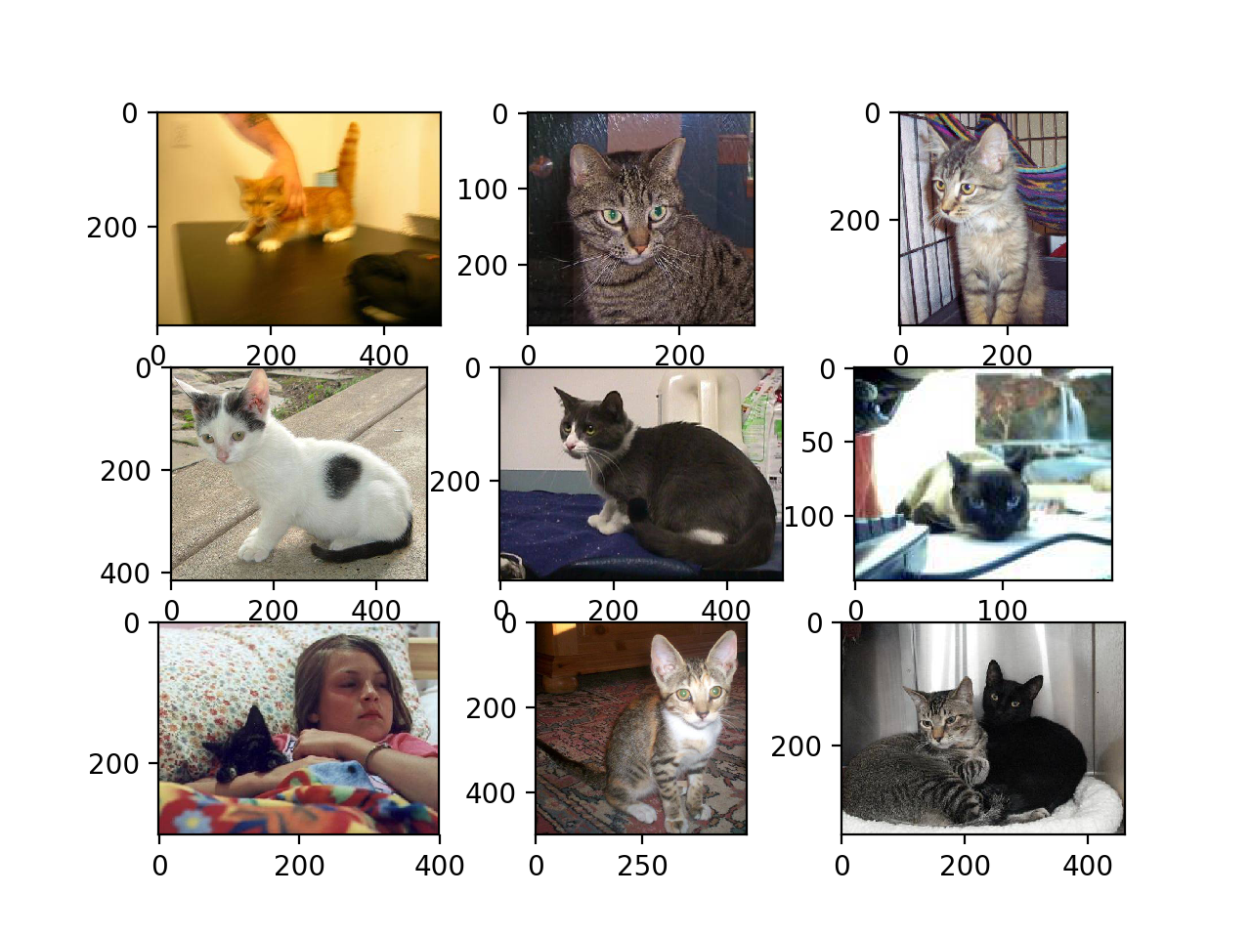
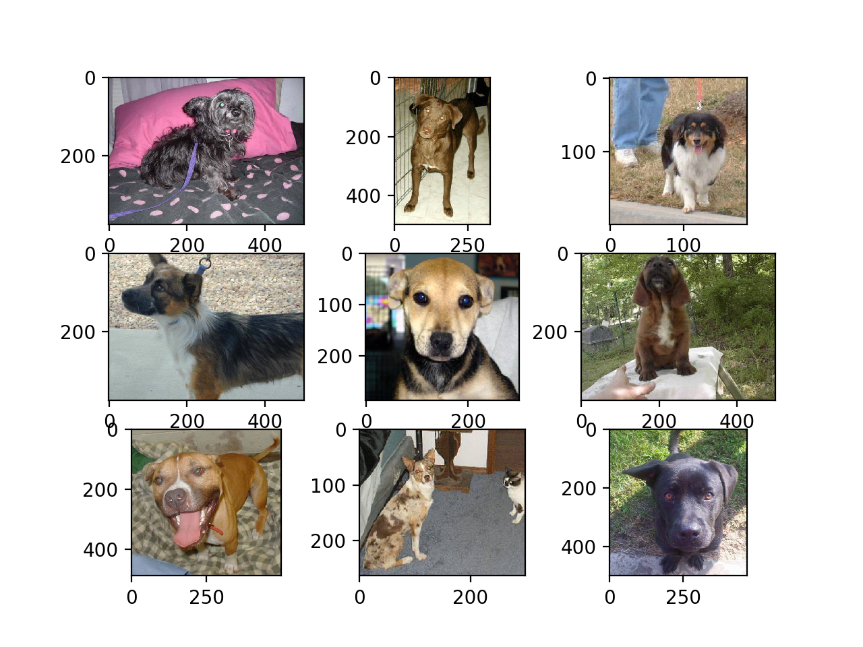
A simpler problem: cat vs. not cat
What are some rules you could use to discriminate between a cat and “not a cat”?
What about upside down cat? Or a cat in the dark or blended in the background?

Slide 4
For most data intensive problems there are way to many ‘rules’ for humans to enumerate

Slide 5
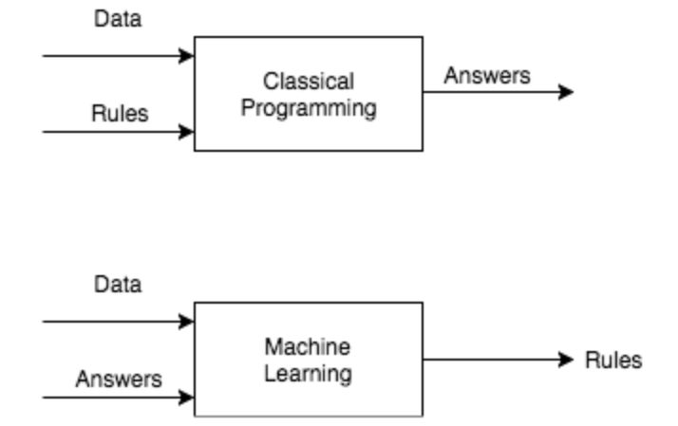
What is a good machine learning problem?
I know a pattern exists!
… but I can’t pin it down mathematically
… AND I have lots of data that demonstrate the pattern
From: Learning From Data
From: Deep Learning with PyTorch

Slide 6

Machine Learning
Field of computer science that studies algorithms that improve through experience
Faghmous, J.H. Machine Learning. In A.M. El-Sayed and S. Galea, Eds., Systems Science & Population Health (2017)

Slide 7
Algorithms that improve through experience

Slide 8

How do we learn the rules using ML?
From: Medium

Slide 9
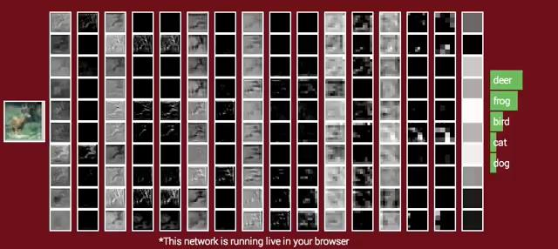
Live demo at: http://cs231n.stanford.edu/
For more examples of ML applications see these slides
James H. Faghmous, Ph.D.

Slide 10
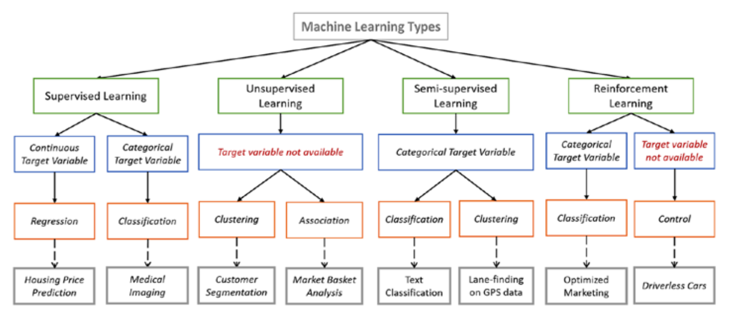
Types of learning problems
Source

Slide 11
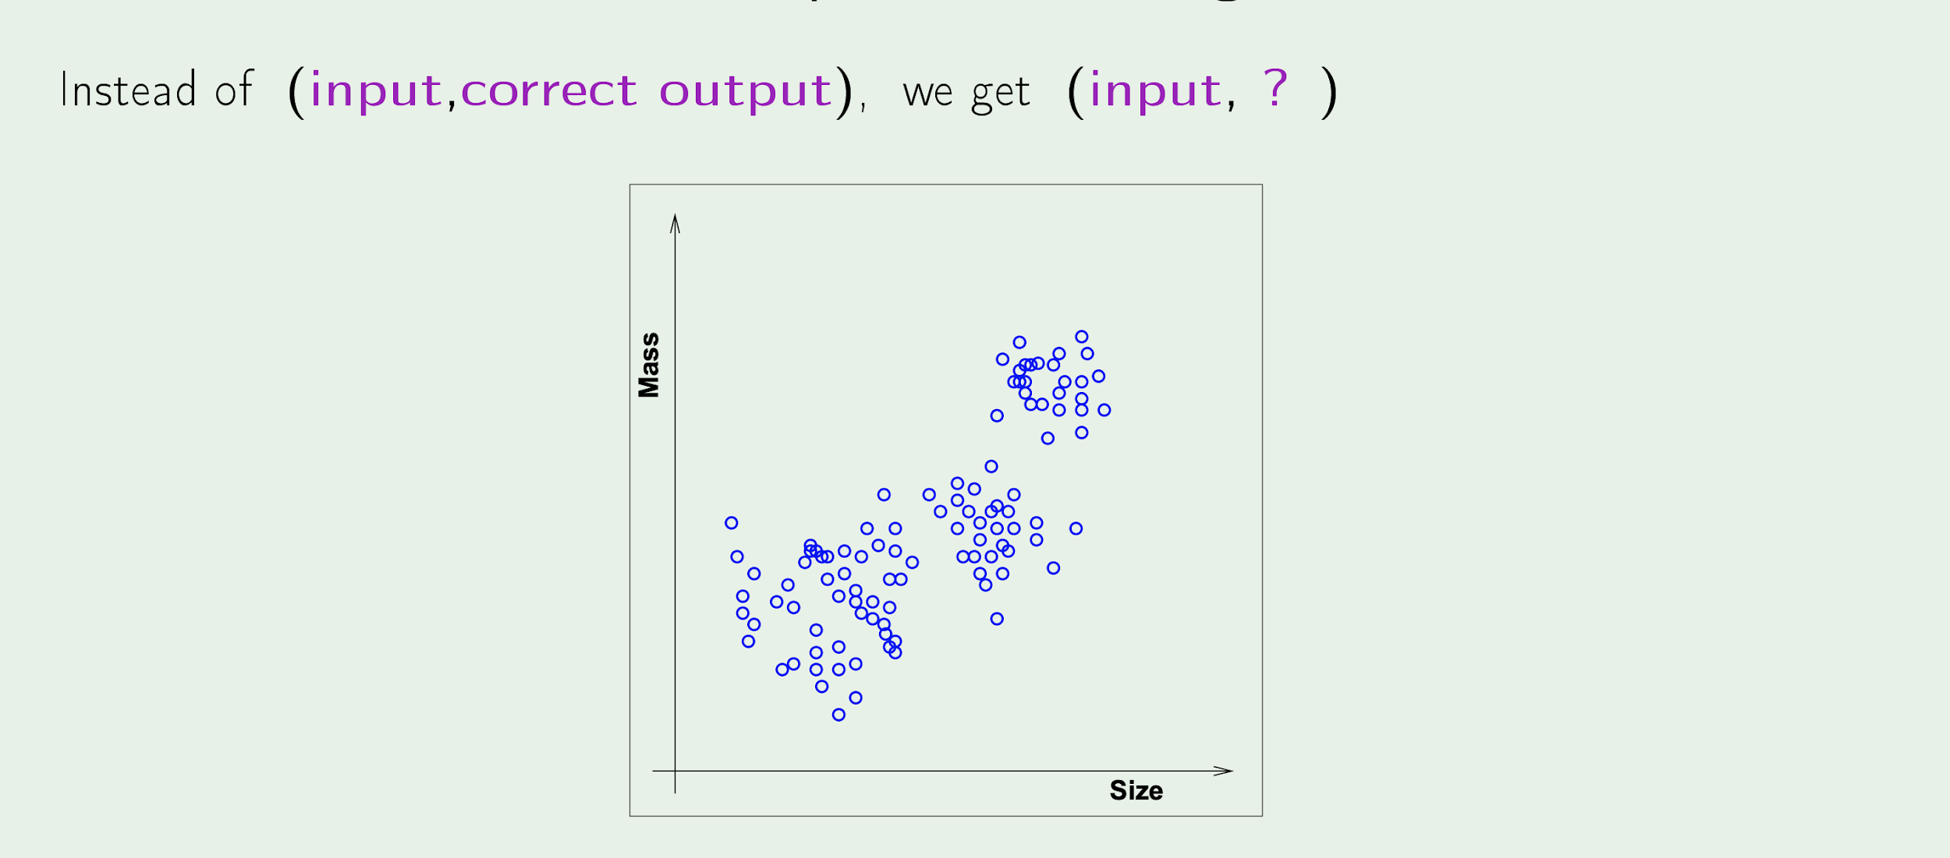
Types of learning problems
Source

Slide 12
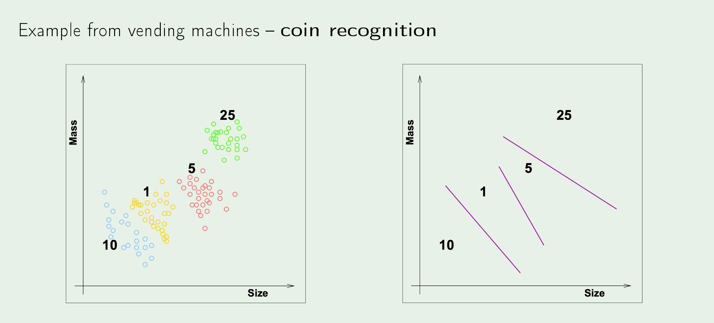
Types of learning problems
Source

Slide 13
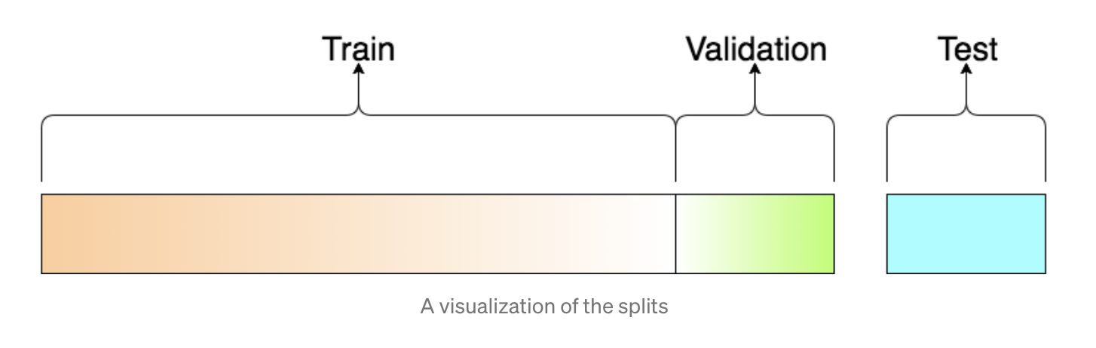
How do we know if the algorithm has “learned” anything?!
Ideally, now my algorithm should send me daily pictures of cats and no pictures of ‘not a cat’
What if I don’t have new data?
We need to simulate “new” data coming in!
Source

Slide 14
How do we know if the algorithm has “learned” anything?!
Given inputs X and outputs y
Build a model that estimates y (known as “y hat”) such that:
The error on the test set is minimal
Understand which inputs X affect the outcome
Understand the uncertainty around our estimates
Source

Slide 15
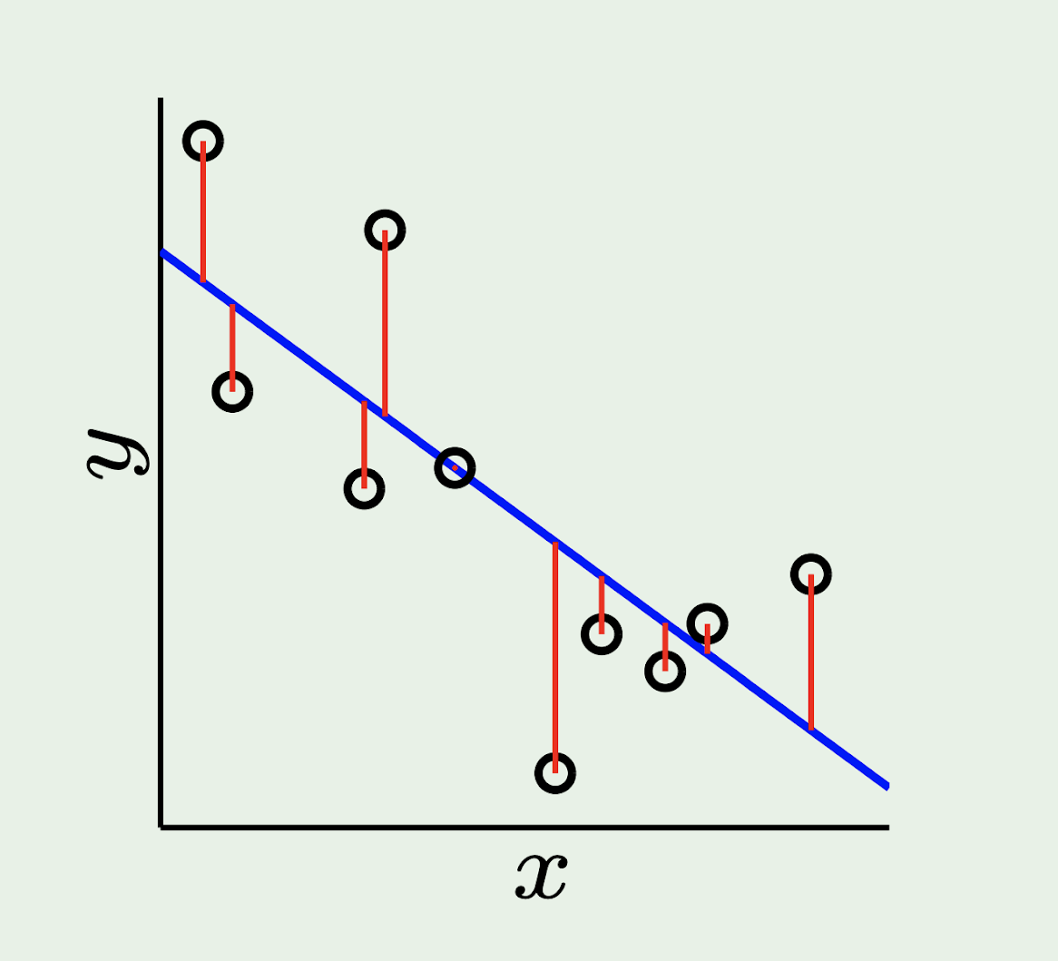
How to evaluate ML algorithms?
If the target/label is continuous (i.e. regression, time-series forecasting, etc.) then compute the difference between y and “y hat” (e.g. mean squared error)
If the target/label is discrete (i.e. classification) then accuracy metrics are used (e.g. #correct classifications / total # of examples)
More on metrics here

Slide 16
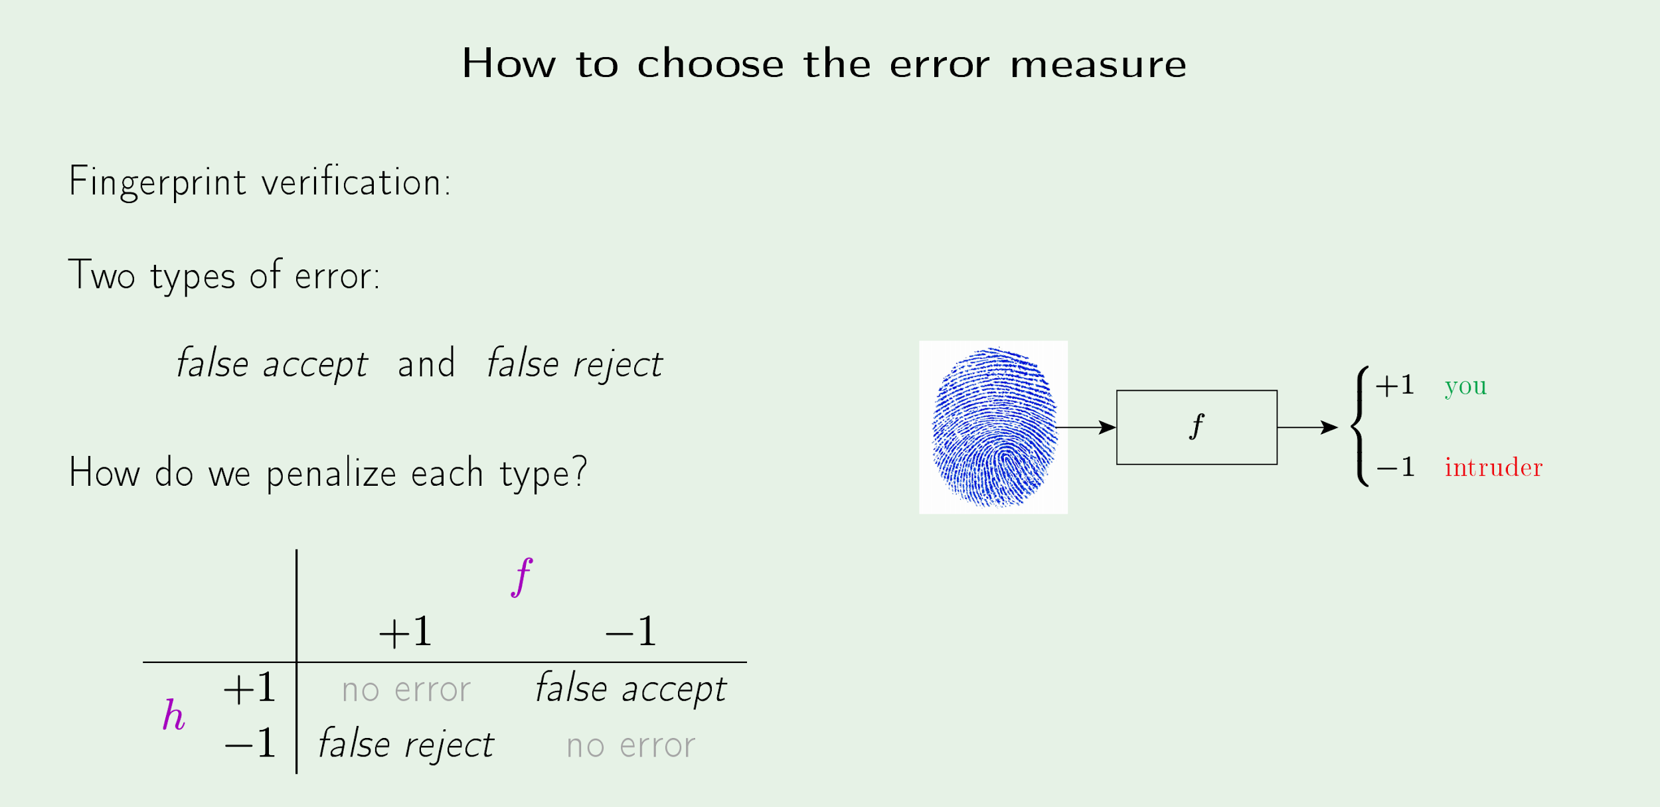
Part I: A Problem
How to choose the right evaluation metric?
Source

Slide 17
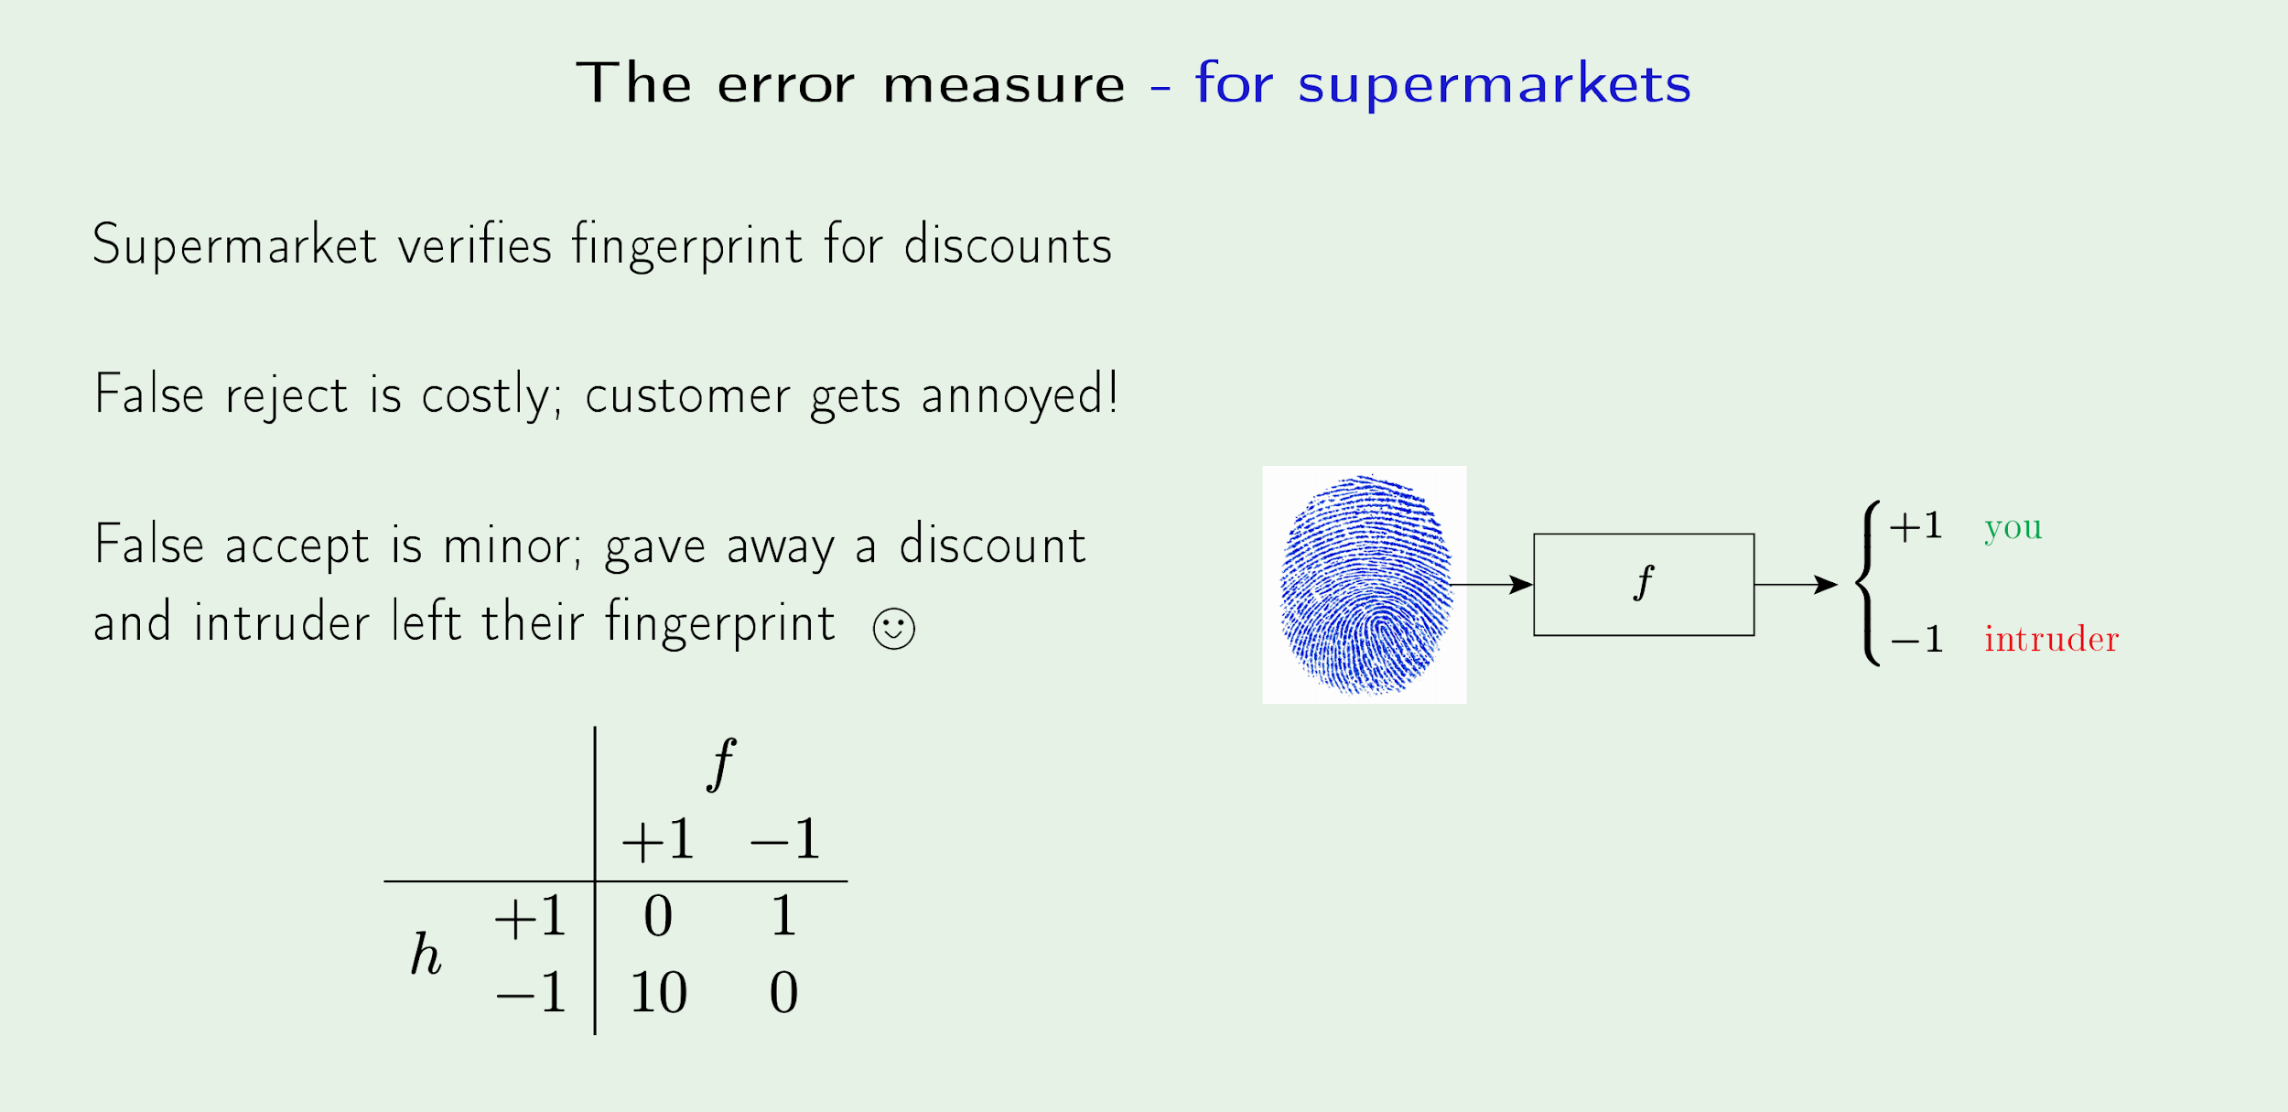
Part I: A Problem
How to choose the right evaluation metric?
Source

Slide 18
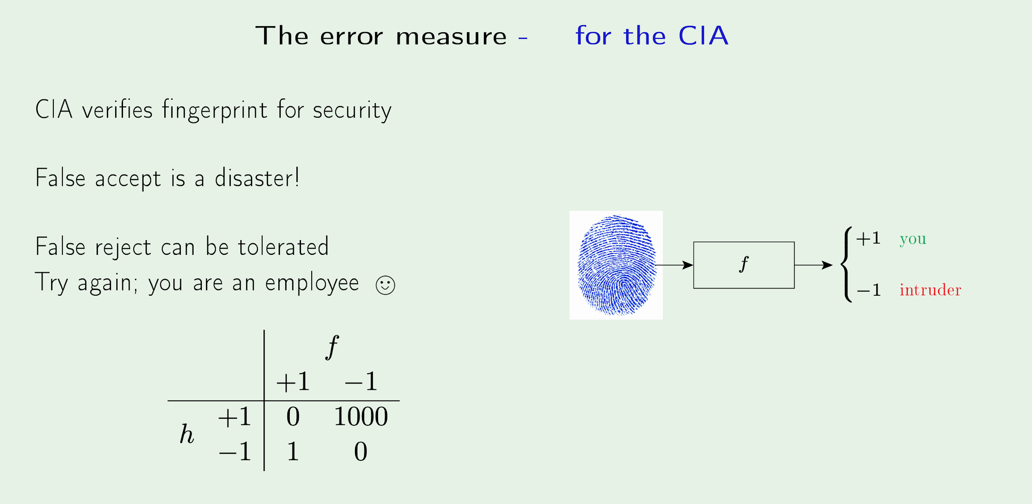
Part I: A Problem
How to choose the right evaluation metric?
Source

Slide 19
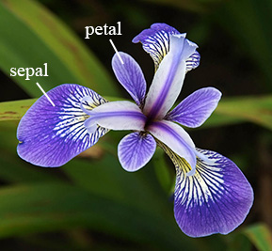

Slide 20
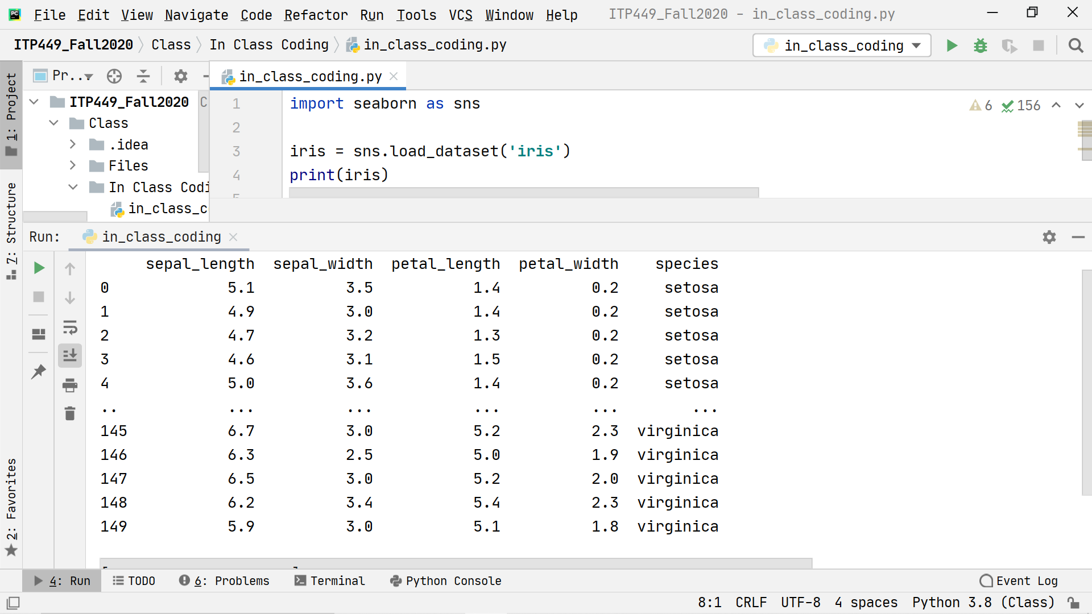
Table of data: Feature matrix X 2D with shape [n_samples, n_features] contained in array or DataFrame
Column: Feature
Number of rows: n_samples
Row: Sample
No of columns: n_features

Slide 21
Dependent variable: Target array y 1D with length n samples contained in array or Series

Slide 22
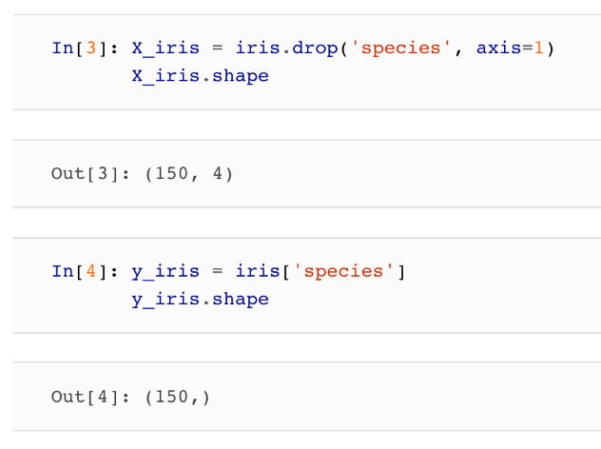
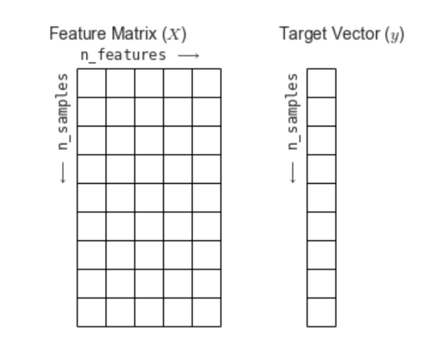

Slide 23
Let’s look at how an ML algorithm learns the rules!

Slide 24
The Machine Learning Formula
Choose Family of Models
Estimate parameters
Q3
Reduce complexity

Slide 25
Family of Models
Linear | Non-Linear | Deep | Probabilistic | Ensembles
Regressions | Trees | Convolutional neural networks | Naive Bayes | Forests
Support Vector Machines | Kernel Methods | Recurrent neural networks | Graphical Models
Perceptron | Neural networks | Auto encoders
 |  | Restricted Bolzmann machines

Slide 26
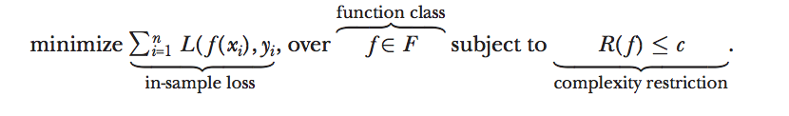
Machine learning in a nutshell
“Minimize loss over function class subject to regularization”
Mullainathan, Sendhil, and Jann Spiess. "Machine learning: an applied econometric approach." Journal of Economic Perspectives 31.2 (2017): 87-106.

Slide 27
Machine Learning Summary
All machine learning methods follow the same pattern
Model parameters are estimated using the “training dataset”
A model is tested on a out-of-sample testing dataset
Models are prevented from overfitting by reducing complexity using the validation dataset

Slide 28
Machine Learning in Practice

Slide 29
Now what?
So now that you know all about ML are you ready to go out and conquer the world?
It’s important to be able to identify opportunities for ML!
Other things to consider are: data, the end-user, and the application!
Suitable
Valuable
Possible

Slide 30
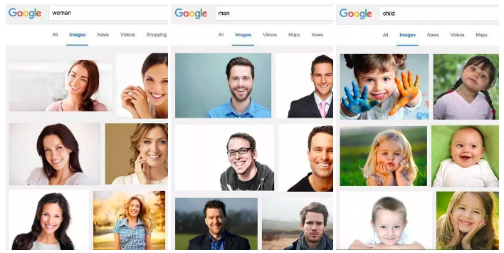
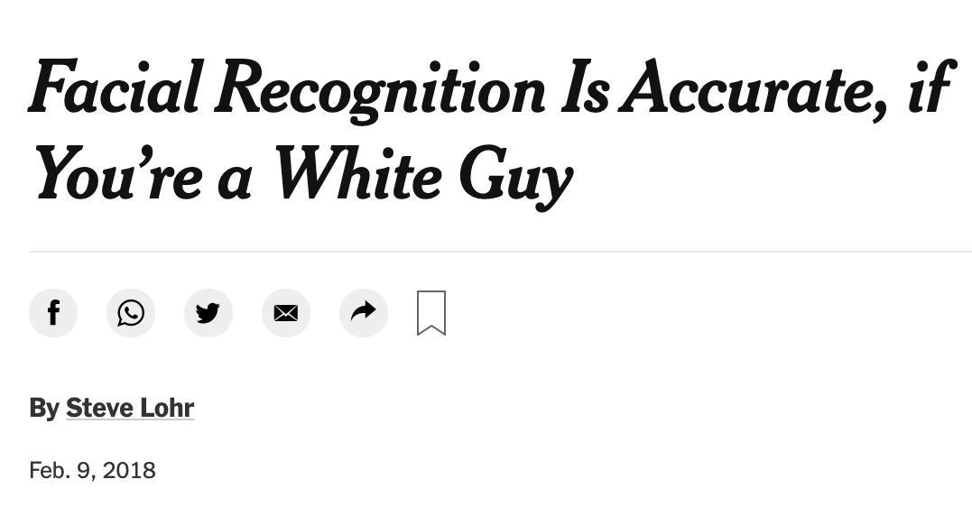
Data
The easiest way to have a bad model is to use bad data.
Many data are heavily biased due to selection bias, convenience sampling, human error, etc,
Trusting a model without any knowledge about its data is like blindly trusting a random person that they are a physician
Article

Slide 31
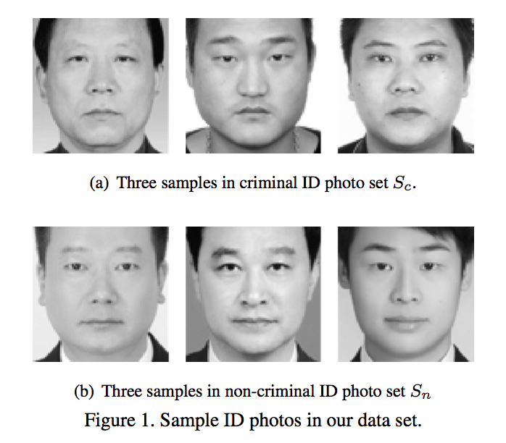
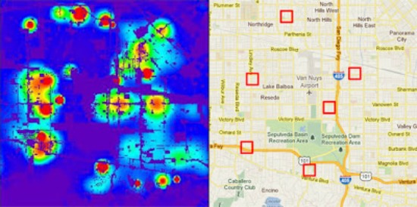
Part III: Practice
Invisible methods
Predictive policing
Recidivism/bail decisions/sententancing
Employment
Credit scores
College admissions
Bias in facial recognition
Recommendations/choices
Discrimination in online delivery

Slide 32
Data Summary
Today, most data are ‘inherited’. Success hinges on getting closer to the data source
Data empathy is a must
Communicating how models are trained is necessary for adoption

Slide 33
Part III: Practice
You are doing amazing!
You’ve found a relevant problem
You collected the appropriate data
You applied ML appropriately
You are getting amazing results!!! It’s just like magic!

Slide 34
Part III: Practice
You are doing amazing!
You’ve found a relevant problem
You collected the appropriate data
You applied ML appropriately
You are getting amazing results!!! It’s just like magic!
Technical innovations are hard but not enough...

Slide 35
Unless you address a user pain, the work will live forever in a notebook

Slide 36
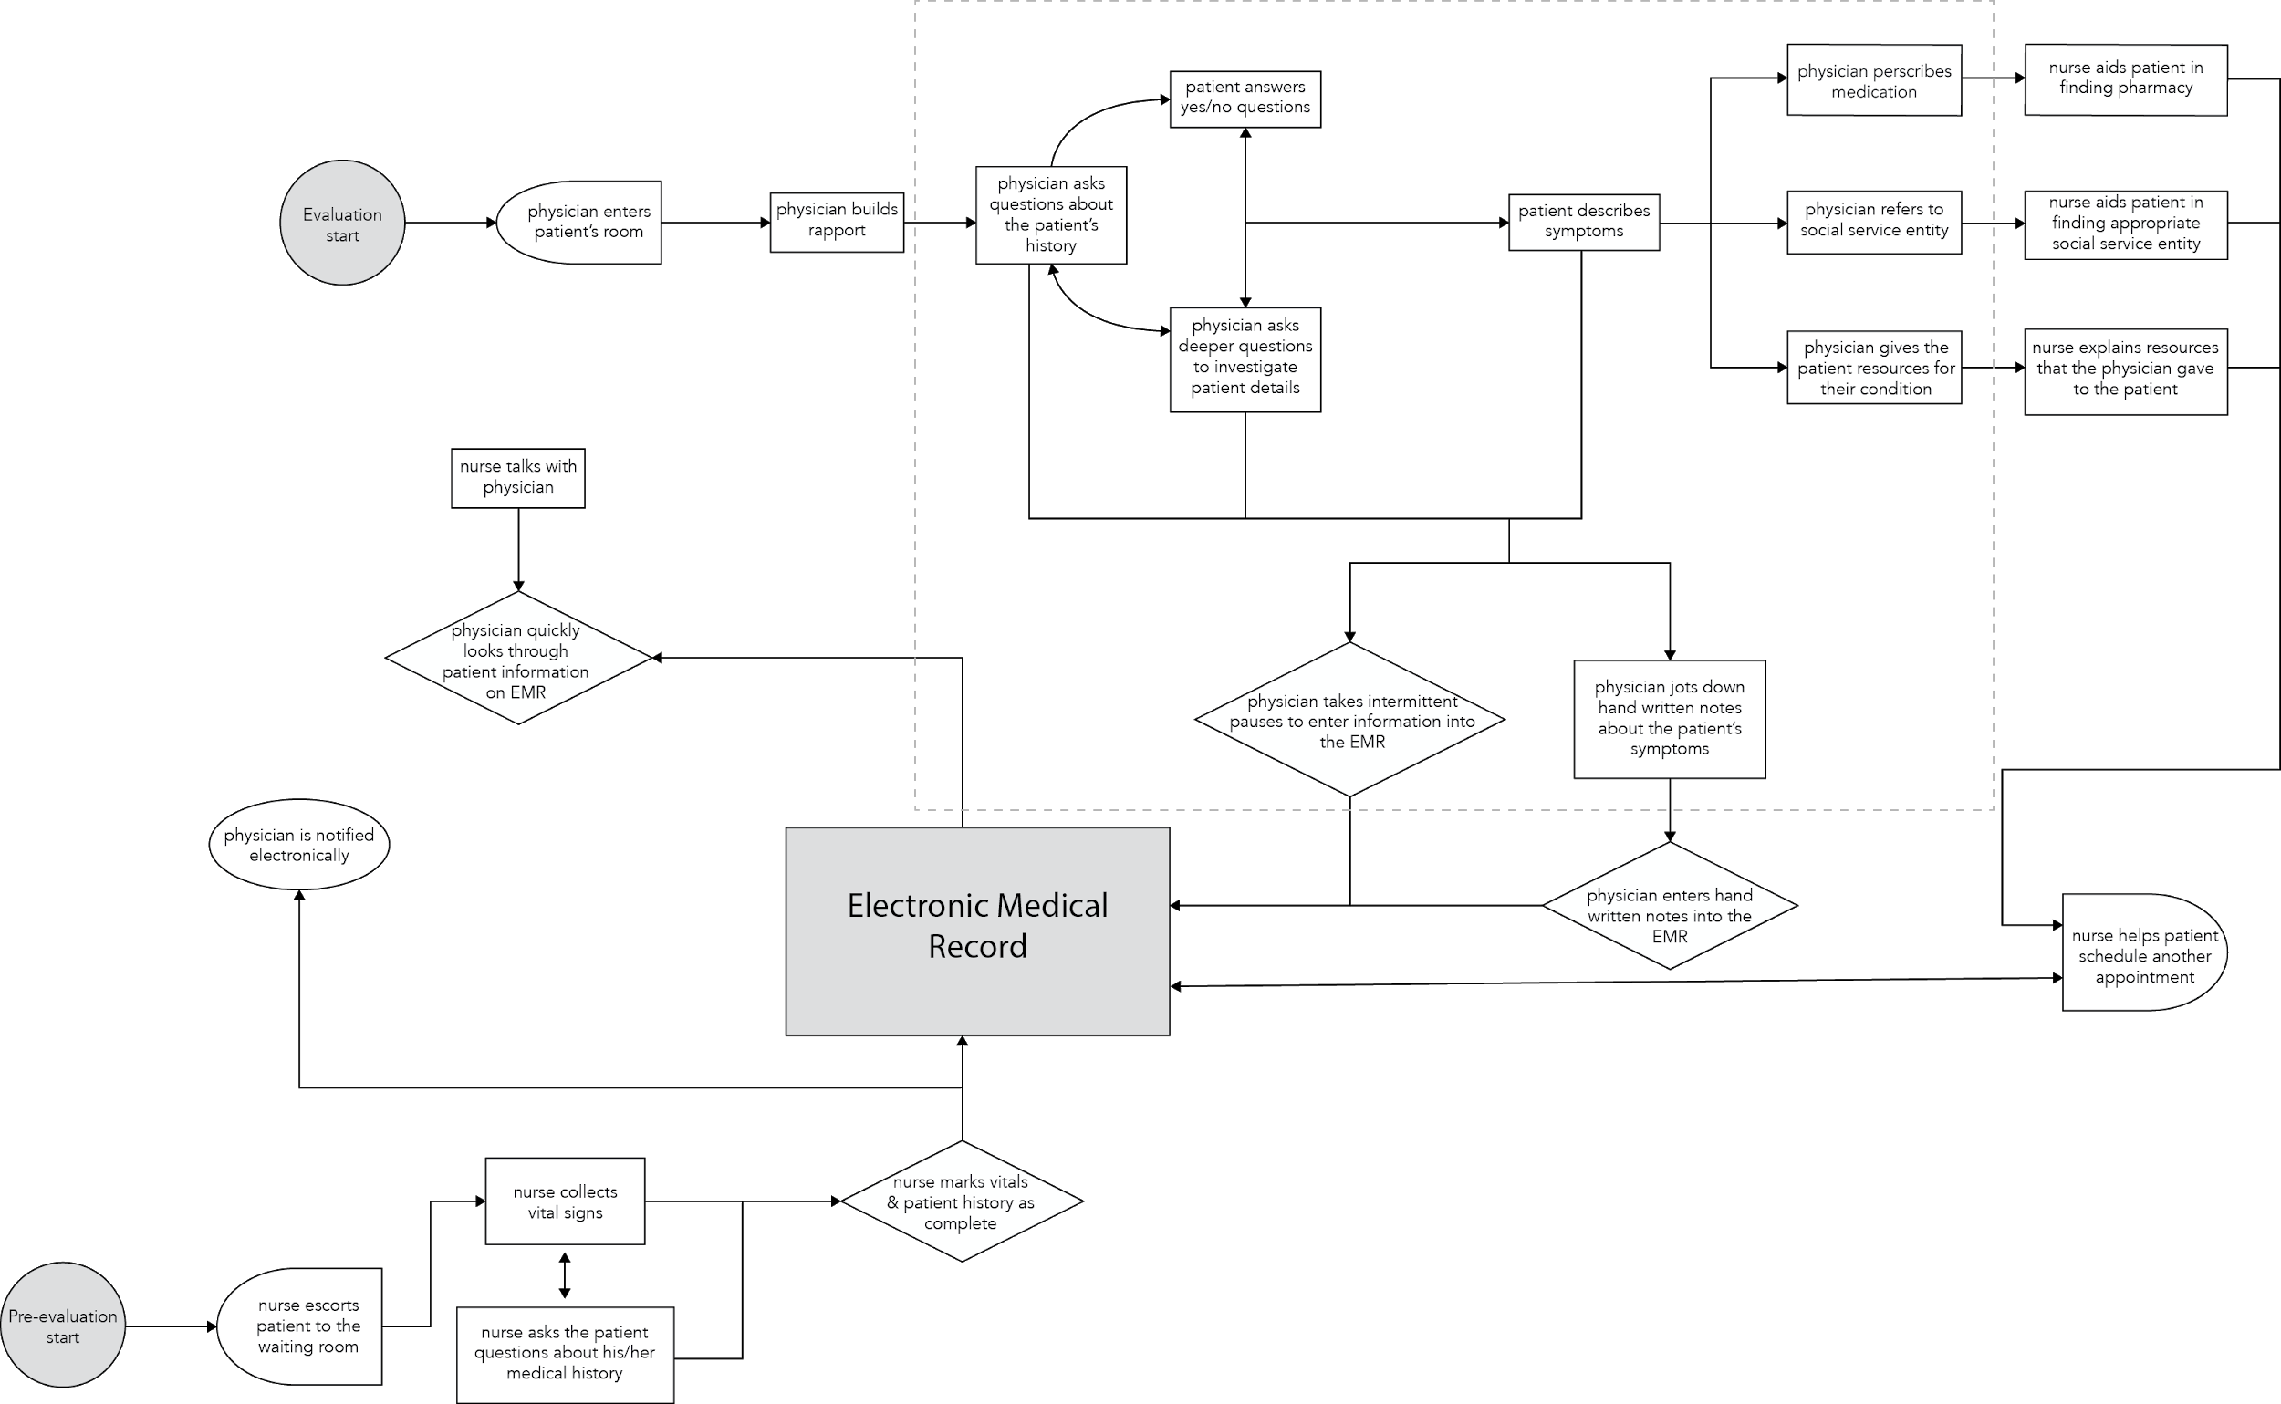
Part III: Practice
Where does your solution fit?
Your users have workflows and responsibilities
How does your solution fit within their workflow?
The solution must come in at little to no additional cost to the user

Slide 37
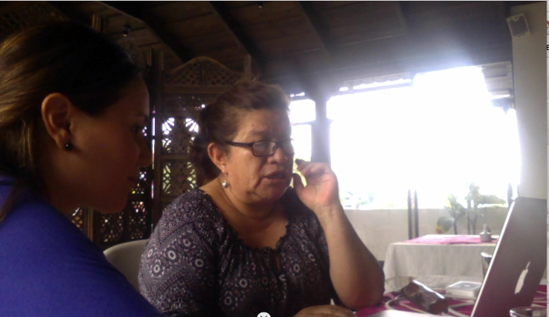
Part III: Practice
ML products: learn from your users
What are their concerns?
Can they interpret the models?
How do you explain how ML works to end-users?

Slide 38
Summary
Machine learning is a discipline that automatically learns complex patterns from large datasets
Machine learning follows a simple formula
There are numerous techniques how to estimate the rules
Be aware that just because an algorithm works it may not be useful
Data are the most critical component for success
Be aware of how your model is used in practice!

